Slide 1
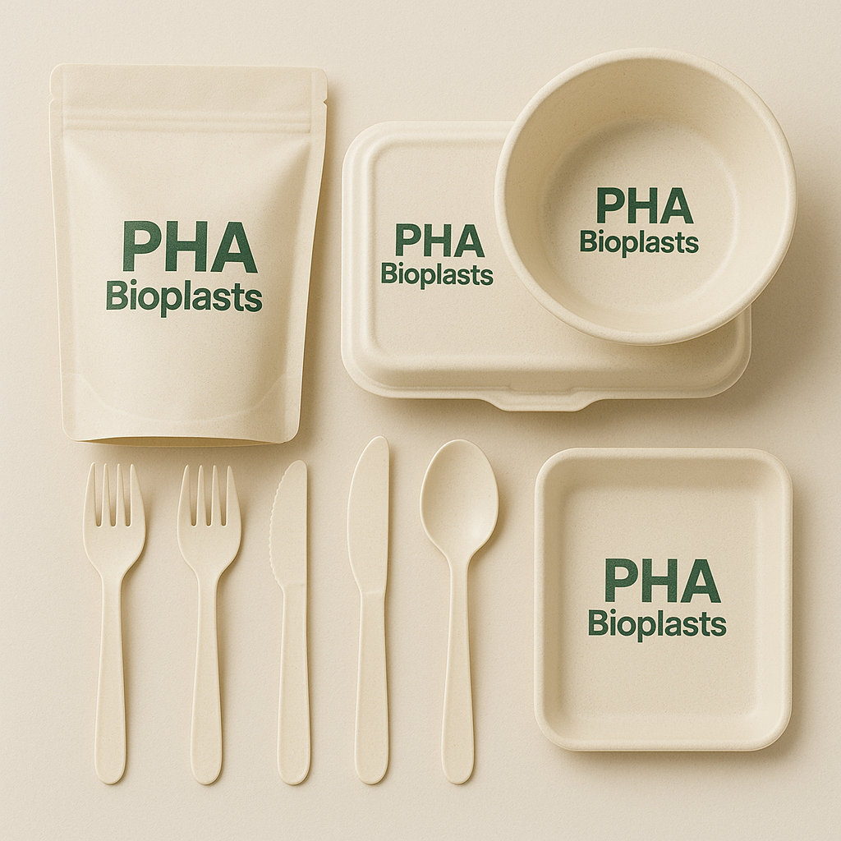


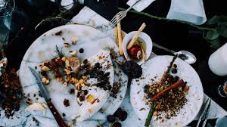


New Venture Development
PHA Bioplasts: Food Waste to Sustainable Packaging
Transforms hospitality food waste into 100% biodegradable plastic for India's sustainable packaging market.
Phase 1 Presentation

Slide 2
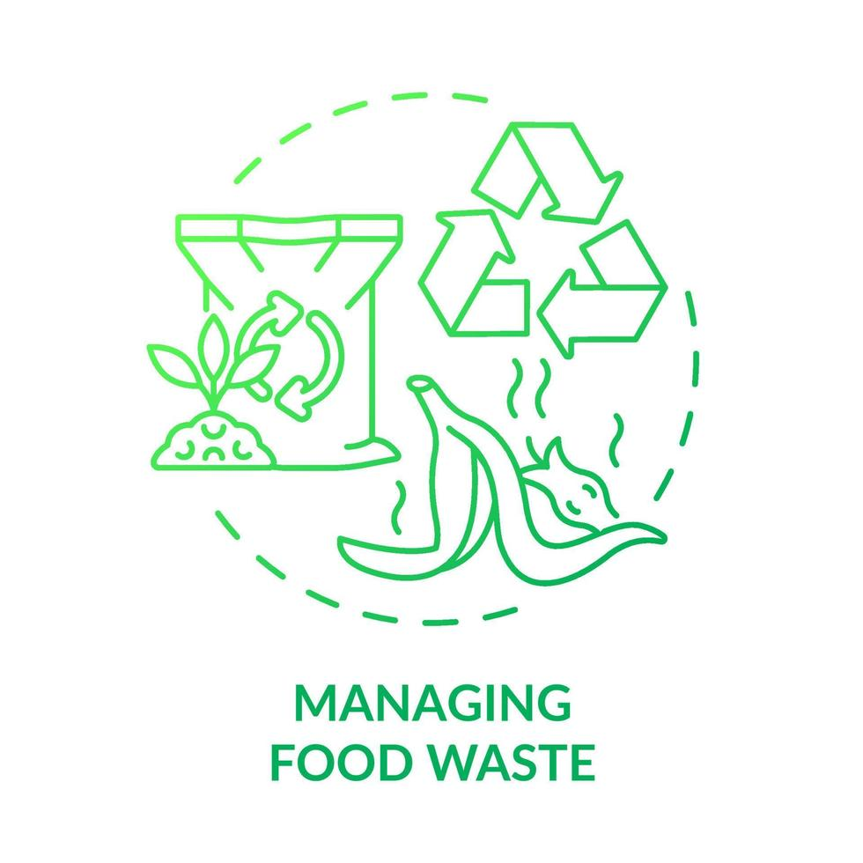
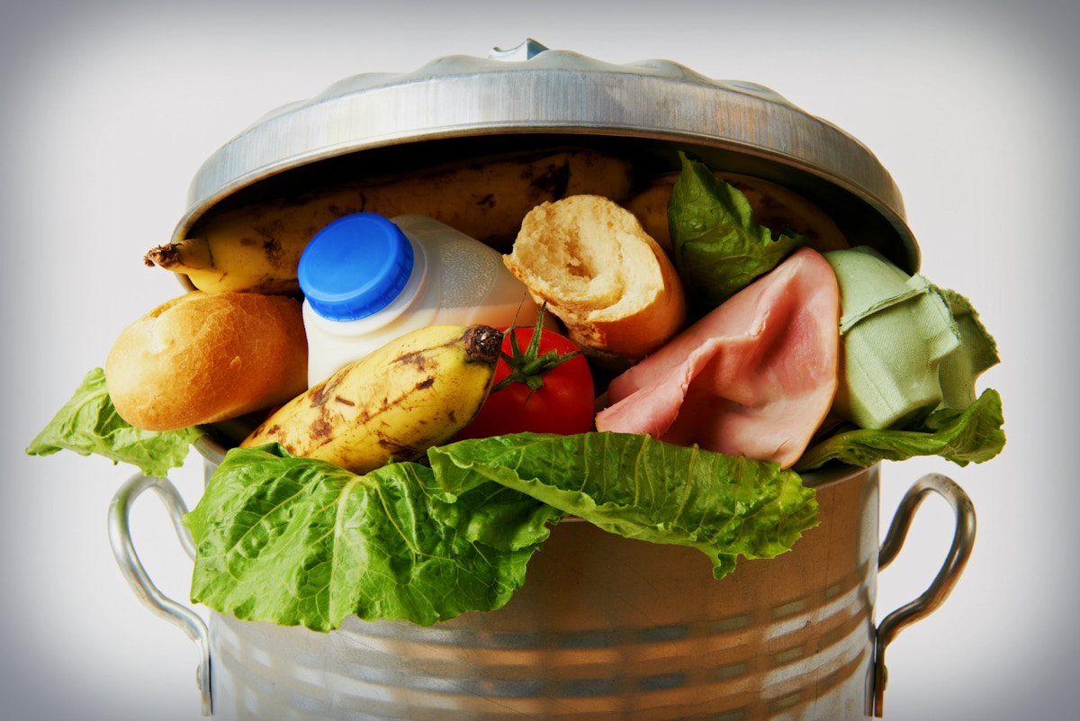
India's Food Waste & Plastic Challenge
Key Problems Identified:
India generates over 78 million tonnes of untreated food waste → methane, landfill load (CPCB, 2023).
Hospitality/QSR chains face pressure to reduce plastic use (Plastic Waste Management Rules 2016 & 2022).
Lack of affordable, high-performance compostable packaging in India.
PHA Bioplasts converts segregated hotel/café/QSR food waste into Polyhydroxyalkanoate (PHA), a 100% biodegradable plastic alternative.

Slide 3
Comparison of Plastic Types vs. PHA
Parameter | Conventional Plastics | PLA/Starch Bioplastics | PHA
Source | Fossil fuels | Crops (corn, sugarcane) | Organic & food waste
Biodegradability | ❌ None | ⚠️ Industrial composting only | ✔️ Fully biodegradable (soil, marine, landfill)
Strength | High | Moderate | High (close to PP)
Heat Resistance | Good | Low | High
Water Resistance | Excellent | Weak–moderate | Excellent
Toxicity | Often contains additives | Safe | 100% non-toxic
End-of-Life | 400+ years | Slow in open environment | Breaks down naturally
Sustainability | High emissions | Medium | Very low carbon footprint
European Bioplastics Report (2024)
Ellen MacArthur Foundation – New Plastics Economy
Journal of Polymers and the Environment (Springer, 2023)

Slide 4
PHA Manufacturers vs. PHA Bioplasts (Gap Analysis)
Company (India) | Type of Bioplastic | Feedstock Used | Limitations | PHA Bioplasts Advantage
Praj Industries (Pune) | Early-stage PHA R&D | Sugar, molasses | Not commercial yet; high cost | Waste-based commercial PHA production
EnviGreen Biotech (Bengaluru) | Starch-based bioplastic bags | Corn starch, vegetable oils | Low heat resistance; weak in moisture | High strength & water resistance PHA
Earthware (Bengaluru) | Plant-fibre compostables | Agri waste | Not plastic-film quality; limited packaging | PHA for thin-film & high-performance packaging
Aakar Innovations (Mumbai) | Corn-starch compostables | Corn starch | Requires industrial composting | Fully biodegradable PHA in natural conditions
Rigel BioEnviron Solutions (Kolkata) | PHA bioplastic production from waste / agro-industrial wastewater | Agro/industrial waste-waters, ETP sludge (rigelgroup.in) | Still small scale; pilot stage; feedstock from distillery waste mainly | Your startup offers broader feedstock (hotel food waste) + scale + tailored packaging solutions
CPCB approved compostable manufacturers list (2024)
Indian Bioplastics Association reports

Slide 5
Strategic Strengths & Risks
Strengths:
Zero-cost feedstock model (waste as carbon source).
Supports sustainability goals (SDG) for hotels/QSRs.
High-performance PHA (food safe, moisture-resistant, EN 13432 compliant).
Aligns with Waste-to-Wealth Mission (Govt. of India).
Single Use plastic Ban by. (CPCB, 2023).
Creates Circular Economy with Hotel chains.
Weaknesses & Challenges:
PHA extraction is technically complex.
Higher current resin cost (₹500–700/kg market).
Need for expert collaboration
Limited Indian PHA production ecosystem.

Slide 6
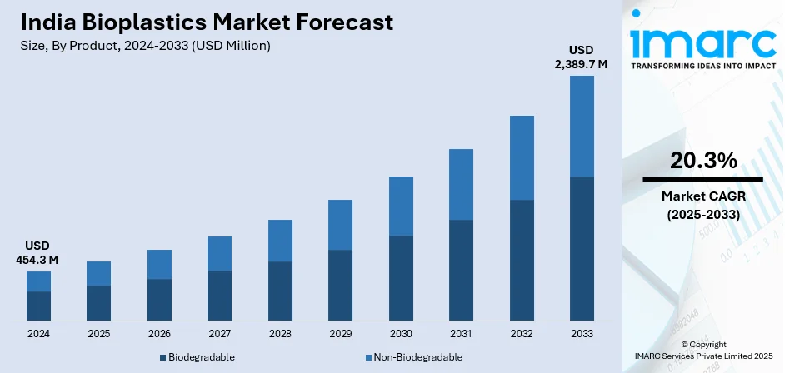
Market Opportunity: TAM, SAM, SOM
Total Addressable Market
India Foodservice Packaging: $34.82B (2024) to $63.11B (2033), 20.3% CAGR. (Source: IMARC 2024)

Slide 7
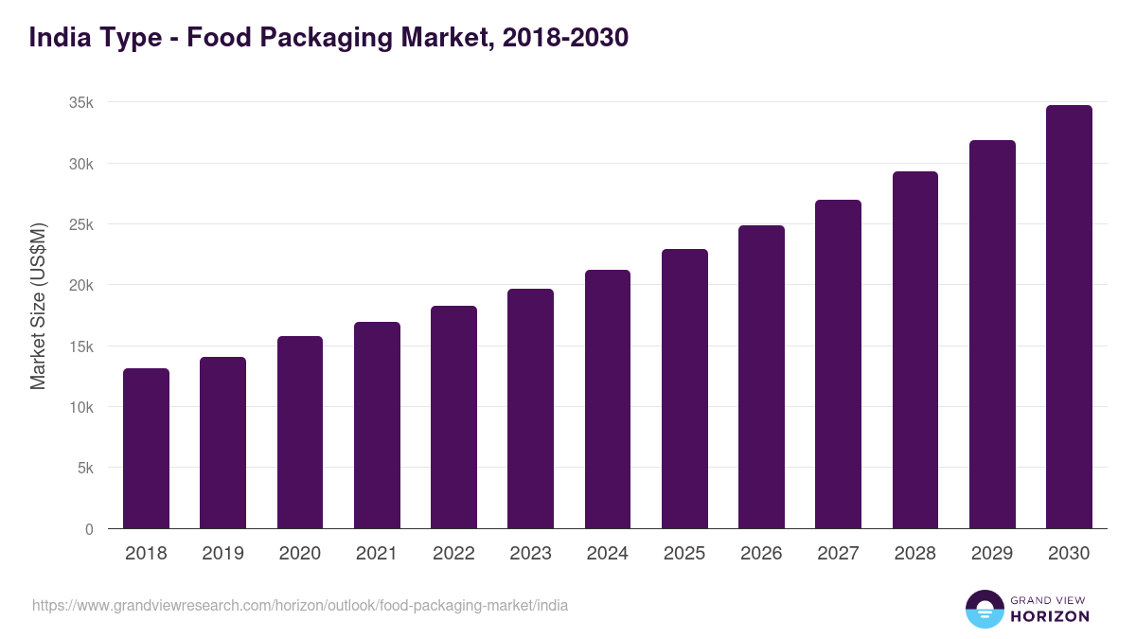
Market Opportunity: TAM, SAM, SOM
Serviceable Available Market
India Sustainable Food Packaging: $4.48B (2024) to $8.96B (2033), 8.2% CAGR. (Source: Grand View Research 2024)

Slide 8
Market Opportunity: TAM, SAM, SOM
Serviceable Obtainable Market (SOM)
Initial Kolkata HoReCa Segment: Significant daily waste contribution from key players.
Daily Waste: 400–600 kg total.
PHA-equivalent: ~100–150 kg/day (25–30% yield).
Annual SOM Value Calculation
Lower bound: 100 kg/day × 300 days × ₹700 ≈ ₹2.1 crore/year
Upper bound: 150 kg/day × 300 days × ₹1,000 ≈ ₹4.5 crore/year

Slide 9
Current Project Status and Achievements
Field Visits & On-Ground Observations
Conducted systematic primary research across multiple HoReCa food-service establishments to map real feedstock availability:
Seduxo Canteen (IMI campus) → 150–200 kg/day segregated organic waste
KFC outlet → 15 kg/day chicken and kitchen waste (high lipid content → high PHA yield potential)
Café Coffee Day → 15 kg/day bakery + beverage residue
India Coffee House → 5 kg/day cooked food waste
WoW Chicken & Momos → 10 kg/day
Kanha Snacks → Packaging requirements study; moisture-barrier issues identified

Slide 10
Current Project Status and Achievements
2. Expert Outreach & Industry Interaction
Initiated communication with Rigel BioEnviron Solutions Pvt. Ltd. (Kolkata) — one of India’s emerging PHA-from-waste producers (BIRAC-assisted).
Communications established with Dr. Partha Chakravarty, requesting: • Technical process overview • Understanding their patented PHA production approach • Feedstock compatibility of hotel waste vs distillery spent wash • Indicative pilot-plant costing • Scope of collaboration & potential site visit

Slide 11
Current Project Status and Achievements
3. Expected Unit pricing
Product Type | Weight | Final Resin Cost Used (₹500/kg realistic scenario) | Processing + Overhead | Final Cost/Unit (before margin) | Final B2B Price (after 25% margin) | Benchmarked Market Price
Cutlery (spoon/fork/knife) | 5 g (0.005 kg) | ₹2.50 | ₹1.50 | ₹4.00 | ₹5.00 per piece | ₹2–₹3 (PLA), source: TradeIndia
Carry Bag (Small/Medium) | 15 g (0.015 kg) | ₹7.50 | ₹2.00 | ₹9.50 | ₹12.00 per piece | Plastic bags vary; tiffin box ₹8/pc (survey)
Bowl/Container | 40 g (0.04 kg) | ₹20.00 | ₹4.50 | ₹24.50 | ₹30.00 per piece | Foil bowl ₹9/pc (survey)
TradeIndia Disposable Biocutlery Listing (2024) — PLA & bagasse cutlery pricing range ₹2–₹3 per piece.
Grand View Research (2024) — India Sustainable Packaging & Bioplastic cost benchmarks.
Fortune Business Insights (2024) — PHA global pricing & resin cost structure.
Nature Scientific Reports (2024) — PHA yield % and fermentation economic modeling.

Slide 12
Specific next steps
1. Technical Validation
Finalize expert guidance from Rigel BioEnviron Solutions (pending reply).
Conduct small-scale fermentation trials.
Verify PHA yield % using real food-waste samples.
2. MVP Development
Produce 50 cutlery + 50 bowls + 50 carry bags using outsourced moulding.
Validate moisture-barrier performance for Kanha Snacks use-case.
3. Market Testing
Pilot trials with Seduxo, KFC, CCD & Kanha Snacks.
Gather feedback on durability, usability & packaging performance.
4. Financial & Costing Refinement
5. Partnerships & Sourcing
Formalize waste-sourcing tie-ups with Seduxo, CCD, KFC outlets.
Explore outsourcing options for moulding & film extrusion.

Slide 13
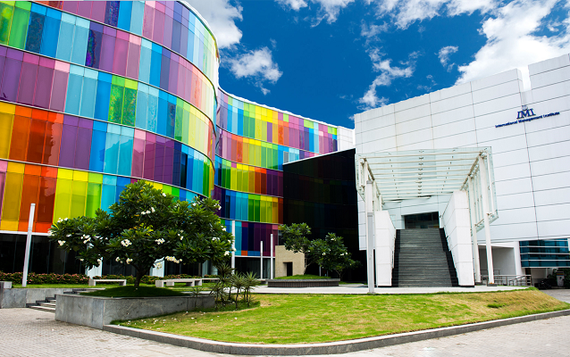





Thank you !
IMI KOLKATA
03366529600
PREET PAIGUDE
AASHISH SALUJA
SIDDHANT JAIN
ABHISHEK TIWARI

